Slide 1

Intro to Ruby

Slide 2
Class Overview
Day 1: Methods, Arrays and Enumerables, Hashes
Day 2: Blocks, Classes, Inheritance
Day 3: Automated Testing with RSpec
Day 4: ActiveRecord CRUD Operations, Associations, Query Interface

Slide 3
Day 1 Overview
Interactive Ruby
Methods
Arrays and Enumerables
Hashes

Slide 4
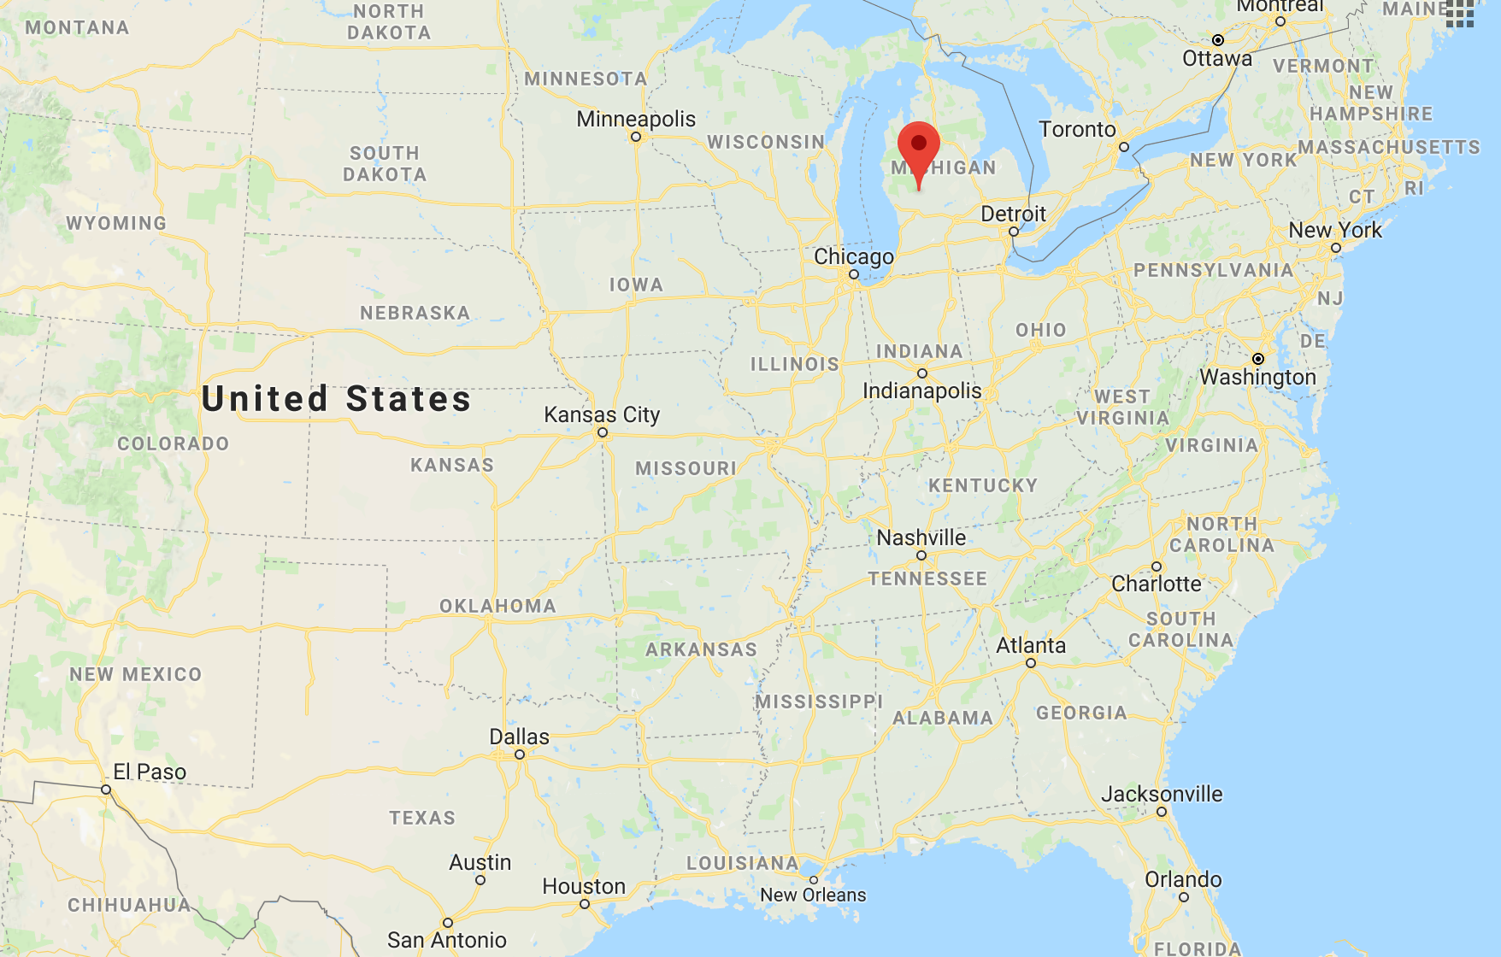
About Me

Slide 5

About Me

Slide 6
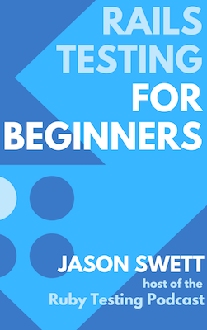
About Me

Slide 7
Interactive Ruby (IRB)

Slide 8
Methods
Method Definitions
Implicit Return
Default Argument Values
Keyword Arguments
Lambda Methods

Slide 9
Method Definitions and Implicit Return

Slide 10
Exercise
Define two Ruby methods: one that returns a value explicitly, another that returns a value implicitly
Load your Ruby file into IRB and call each one of your methods

Slide 11
Default Argument Values and Keyword Arguments

Slide 12
Exercise
Define a method that has a default value for at least one argument (no keyword arguments)
Call that method with that argument present and then with that argument absent
Define a method that takes keyword arguments, at least one of which has a default value
Call that method with all arguments present, call that method with at least one argument absent
Intentionally abuse your methods by calling them invalidly. Observe the error messages.

Slide 13
Lambda Methods

Slide 14
Exercise
Write a lambda method that takes no arguments and then call it
Write a lambda method that takes at least one argument and then call it

Slide 15
Arrays and Enumerables
Array Syntax
each
map
select

Slide 16
Array Syntax and .each

Slide 17
Exercise
Define an array where each element is a first and last name (e.g. “Michael Jackson”)
Write an each block which prints each person’s last name

Slide 18
.map

Slide 19
Exercise
Define an array where each element is a first and last name (e.g. “Michael Jackson”)
Write an map block which returns an array where each element is a last name

Slide 20
.select

Slide 21
Exercise
Define an array where each element is a first and last name (e.g. “Michael Jackson”)
Write a select block which returns an array where each element is a full name, but only contains names that are alphabetically before M

Slide 22
Hashes

Slide 23
Exercise
Define a hash where each key is a symbol. Print a couple values from the hash. Try .keys and .values on the hash.
Define a hash where each key is a string. Print a couple values from the hash. Try .keys and .values on the hash.

Slide 24
Iterating over hashes

Slide 25
Exercise
Define a hash with several keys and values
Iterate over the hash, printing each key and value

Slide 26
Day 1 Review
Interactive Ruby (IRB)
Methods
Arrays and Enumerables
Hashes

